Slide 1

Sauce & Spoon
Tablet Rollout
Impact Report

Slide 2
Executive Summary
Sauce & Spoon is initiating a pilot program to implement tabletop menu tablets at two locations: Sauce & Spoon North and Sauce & Spoon Downtown. The project involves selecting appropriate hardware and vendors, updating the digital menu with enhanced features, training staff, and installing the tablets in the bar areas of both restaurants.
The rollout is scheduled to begin in early Q2 (April) and will be monitored
through the end of June to evaluate its impact and success.
The project follows a primarily waterfall approach, with Agile principles integrated to allow for flexibility in adapting to changes in timeline, budget, and execution.

Slide 3
Accomplishment Summary
Reduced average table wait time to under 10 minutes
Successfully reduced table turn time by 30 minutes.
Maintained average tablet checkout time has stayed at one minute or less.
Achieved less than 5% of customer’s reporting technical issues each week.
Increased daily guest count by over 20% at the Downtown location.
Achieved a 25% reduction in food waste.

Slide 4
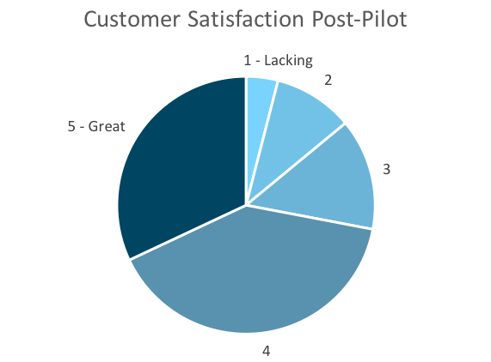
Customer Satisfaction: Pilot
Q. On a scale of 1-5, please rate your experience with the tablet overall.
This pie chart illustrates the results from the post-pilot survey.
72% of respondents indicated a customer satisfaction score of 4 or 5.
Notes:
First pie chart: Results from the post-pilot survey
Second pie chart: Results from the post-launch survey, after making changes
Satisfaction has gone up from 72% (4 and 5 rating) to 86% (4 and 5 rating)
Post-pilot data:
1 - Lacking 2 4%
2 5 10%
3 7 14%
4 20 40%
5 - Great 16 32%
Post-launch data:
1 - Lacking 1 2%
2 2 4%
3 4 8%
4 22 44%
5 - Great 21 42%

Slide 5
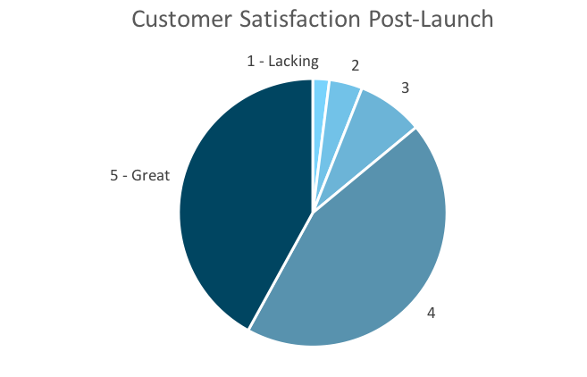
Customer Satisfaction: Launch
Q. On a scale of 1-5, please rate your experience with the tablet overall.
This pie chart illustrates the results from the post-launch survey.
86% of respondents indicated a customer satisfaction score of 4 or 5. This is a 14% increase.
Notes:
First pie chart: Results from the post-pilot survey
Second pie chart: Results from the post-launch survey, after making changes
Satisfaction has gone up from 72% (4 and 5 rating) to 86% (4 and 5 rating)
Post-pilot data:
1 - Lacking 2 4%
2 5 10%
3 7 14%
4 20 40%
5 - Great 16 32%
Post-launch data:
1 - Lacking 1 2%
2 2 4%
3 4 8%
4 22 44%
5 - Great 21 42%

Slide 6
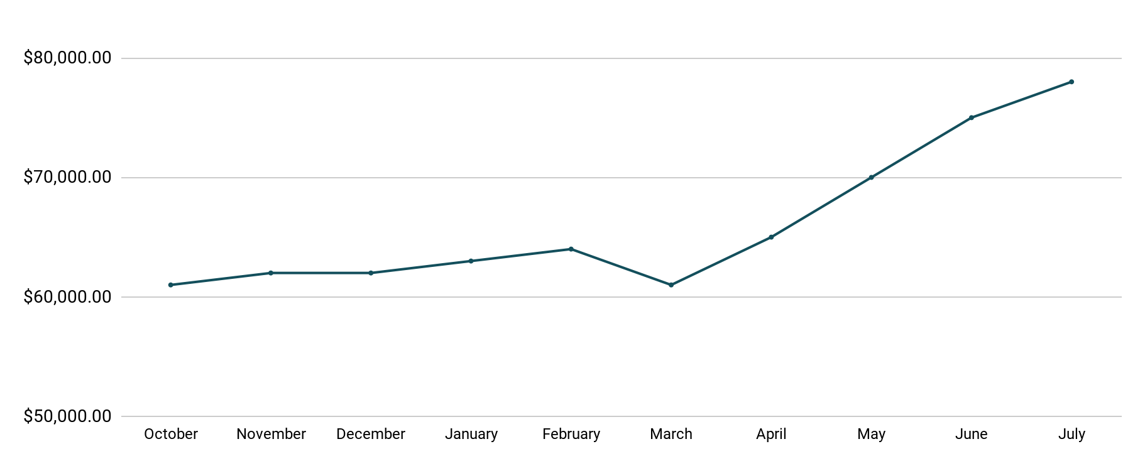
Revenue
Tablet Launch April 23
This is a chart of Sauce & Spoon revenue, showing that after tablet implementation, revenue increased.
July revenue was up to 20% over April’s monthly revenue.
Notes:
This is a chart of Sauce & Spoon revenue, showing that after tablet implementation, revenue increased. December revenue was up to 20% over September’s monthly revenue.
Sales data:
October
$61,000.00
November
$62,000.00
December
$62,000.00
January
$63,000.00
February
$64,000.00
March
$61,000.00
April
$65,000.00
May
$70,000.00
June
$75,000.00
July
$78,000.00

Slide 7
What Worked: Key Accomplishments
Decreased table turn time
Tablet implementation increased the average daily guse count by 10%.
Tablets also decreased wait time by 30 minutes.
Decreased food waste
Tablets helped identified who was receiving an incorrect order.
Kitchen staff proactively corrected mistake, leading to 50% reduction in food waste.
Increased customer satisfaction
After the pilot, customer satisfaction was at 72%.
After implementing feedback driven improvements, customer satisfaction rose to 86%.
Increased sales
Monthly revenue has increased steadily since the tablet rollout, upwards of 20% since September/pre-rollout.
Tablets also contributed in boosting revenue during the holiday season.

Slide 8
Next Steps: Looking Forward
Continue monitoring and update installed tablets
Focus on increasing guest count at the Riverfront location by over 20%
Continue to improve order accuracy
Maintian regular surveys and solicit guest feedback.

Slide 9
Next Steps: Initiative & Action
Initiative | Action | Date
Implement tablets in more locations | Create new project plan for new location installation | Q2
Continue to track customer experience and satisfaction | Continue surveying/ gathering data through various means | Ongoing
Expand tablet features | Investigate new features like social media integration, reservations, videos, etc. | Q4

Slide 10
Lessons Learned
Guests intitially had difficulty with tablet navigation, so we improved the layout to be more user-friendly.
After struggling to reduce table turn time, we collaborated with the general managers on staff training focused on guest pacing, ultimately achieving the 30 minute reduction.
Ongoing frustrations with the cash payment system led us to add more registers and retrain staff to improve the experience.

Slide 11
Appendix
Project Charter
Project Proposal
Project Plan
Stackhollder Analysis
Survey Results Presentation
Notes:
Insert link to your shared drive or a shared folder with all of the relevant project artifacts

